Slide 1

MS-4007 Copilot for Microsoft 365 User Enablement Specialist

Slide 2

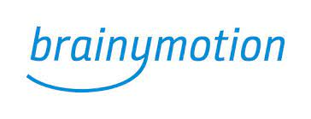
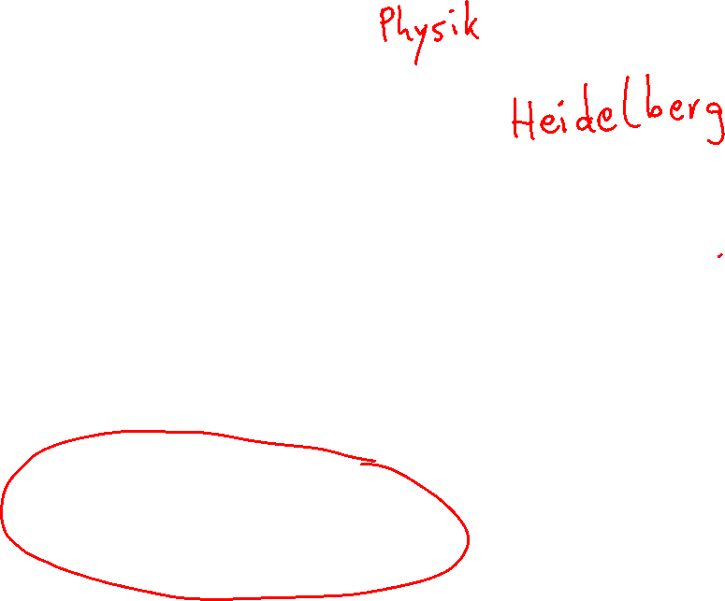
Thomas Jäkel
Lead Trainer Cloud Infrastructure
Microsoft Certified Trainer since 1999
github.com/www42/openAI

Slide 3

Agenda
Explore user enablement strategies for adopting Copilot
Envision a successful adoption of Copilot
Onboard and empower your employees to use Copilot efficiently
Drive value and maximize the impact of Copilot within your organization
Extend and optimize Copilot in your organization

Slide 4

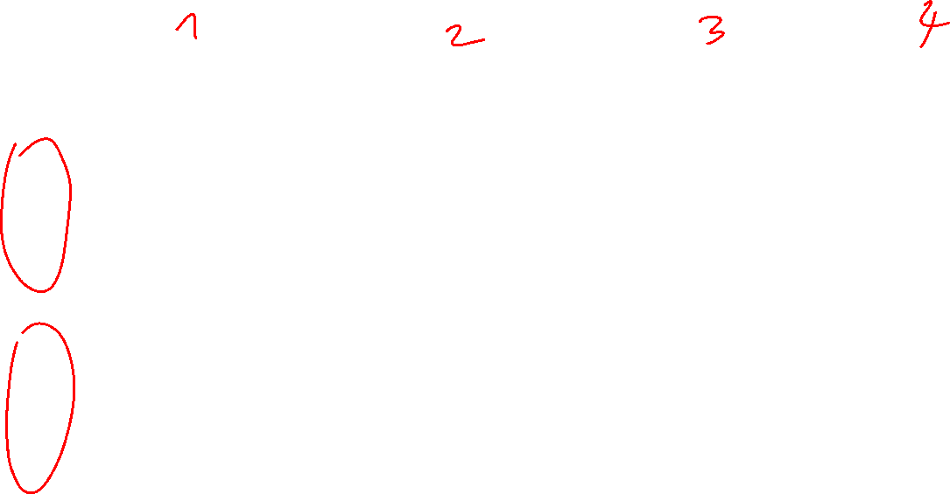
Copilot for Microsoft 365
Implementation overview
Get ready
Onboard & engage
Deliver impact
Extend & optimize
User Enablement Workstream
Complete User Enablement Strategy training
Define user experience and feedback strategy
Design and deploy training and engagement community (Center of Excellence/Champion Platform)
Launch employee communications and Champion program
Onboard executives and user cohorts
Deliver user Champions and support staff training
Review success measures and user survey results
Conduct feedback and reporting analysis
Deliver extended training and adoption support
Identify additional optimization scenarios
Iterate user experience strategy
Gather and amplify success stories
Extend to new high value scenarios
Deliver business process transformation with Copilot Studio, plugins, and connectors
Drive group and cross-organizational productivity and innovation
Understand custom line of business opportunities
Secure exec sponsorship, create AI Council, and define RAI principles
Identify success owners, Champions, and early adopter cohorts
Detail high value scenarios and personas
Be intentional with assignment and concentrate seats
Define success criteria, KPIs, and success measurement plan
User Enablement
Technical Readiness Workstream
Ensure appropriate Data Security controls are in place
Prepare your organization for Copilot for Microsoft 365 with setup guide: deploy Microsoft 365 apps, if needed; assign licenses
Assign permissions by role to provide access to the Copilot for Microsoft 365 usage report
Establish service management plan
Analyze Copilot for Microsoft 365 usage reports and the Microsoft Copilot Dashboard to observe user adoption, retention, and engagement
Design, build, and publish plugins to deliver unique experiences
Build your own copilots
Perform the Copilot for Microsoft 365 Optimization Assessment
Address data security, governance, and data access questions
Build shared Copilot for Microsoft 365 implementation plan with User Enablement team
Technical Readiness

Slide 5
Agenda
Explore user enablement strategies for adopting Copilot
Envision a successful adoption of Copilot
Onboard and empower your employees to use Copilot efficiently
Drive value and maximize the impact of Copilot within your organization
Extend and optimize Copilot in your organization

Slide 6
Let’s get to know each other
Your name
Company affiliation
Title/function
Your experience
Your expectations for the course

Slide 7


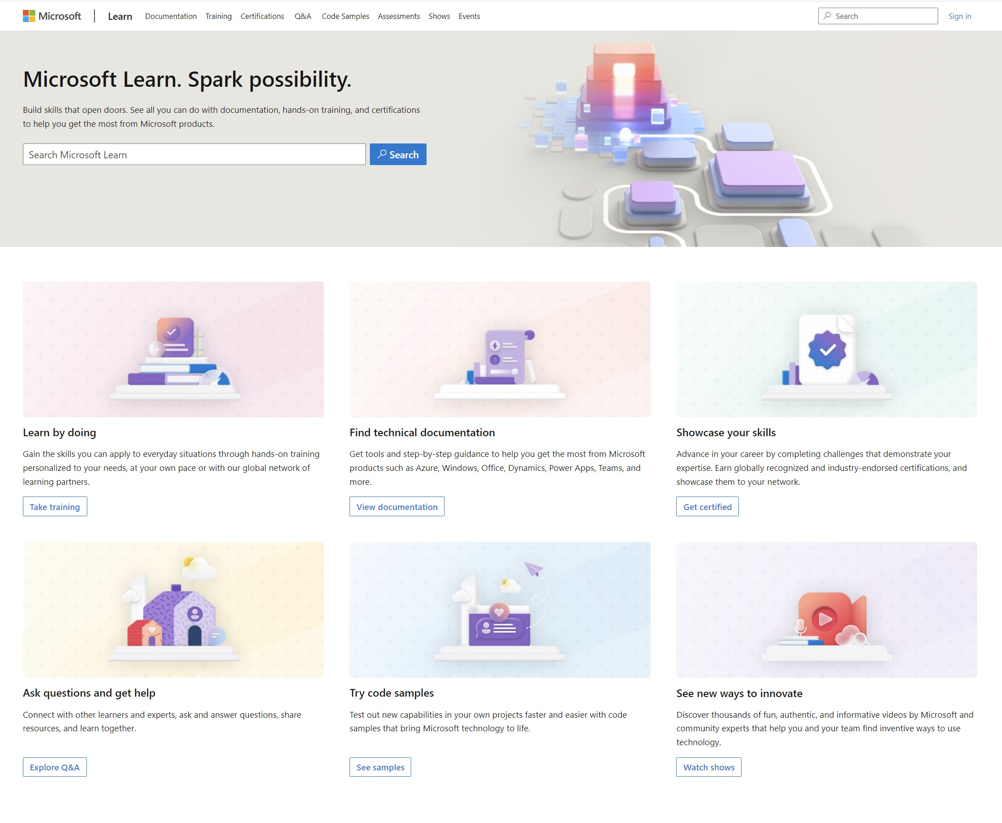
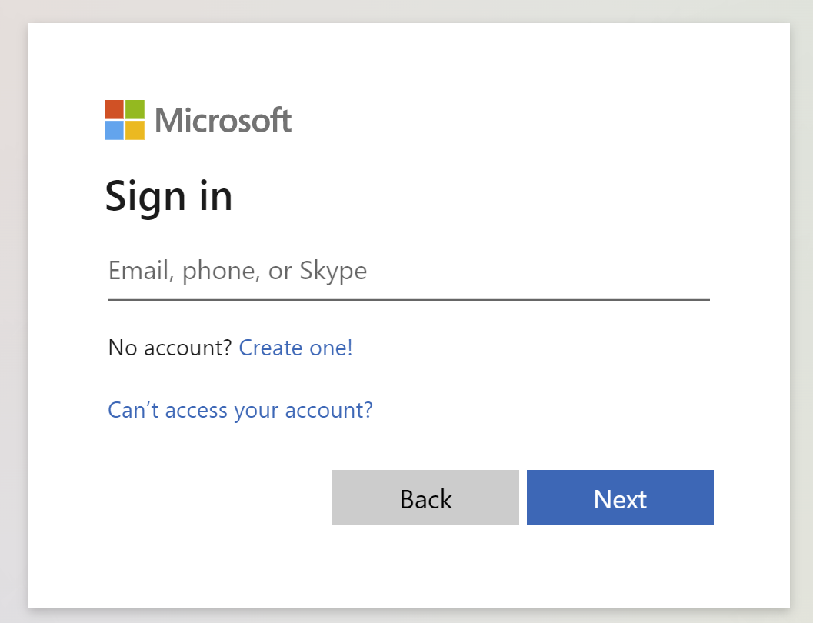
Get the most out of your Microsoft Learn profile
Verify, track, and share your training and certification progress and accomplishments—all on one platform
Create your Microsoft Learn profile at learn.microsoft.com
Claim your achievement code for this course and share you have completed it.
Access your course material and track progress on your learning activities.
Share and verify your Microsoft Certifications via email, on social networking platforms, and on your résumé.
Download and print transcripts and certificates.
Manage your upcoming activities and certification exam appointments.
www.aka.ms/MyMicrosoftLearnProfile
Notes:
Select Sign in at the top, right corner of any Microsoft Learn page.
Follow the Microsoft account authentication process.
If the account that you have chosen to sign-in with doesn't already have a Microsoft Learn profile, you’ll be guided to create one.

Slide 8
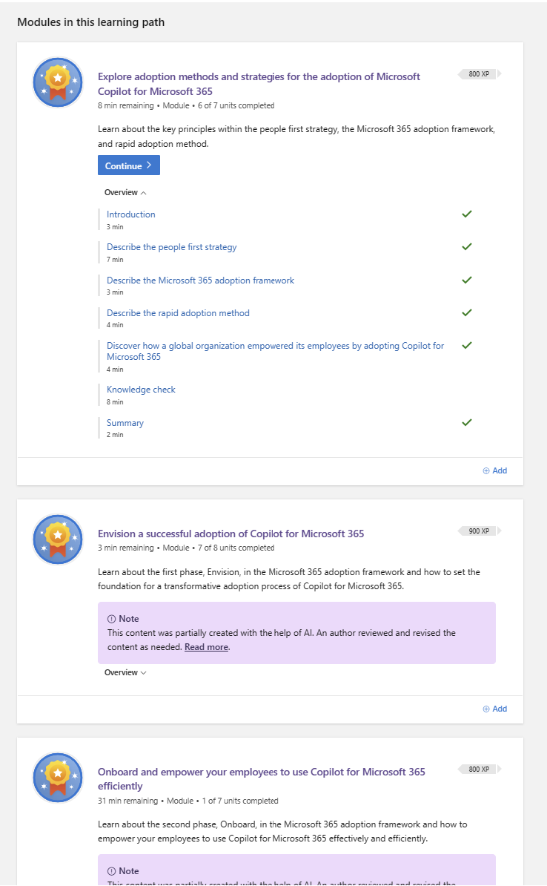
Access your course materials
All course content is available on Microsoft Learn
Secure storage for Azure Files and Azure Blob Storage - Training | Microsoft Learn
We’ll go through this content together and as the course progresses, I will advise you on which modules to review.
You can provide feedback for modules on Microsoft Learn. Use the link at the bottom of the page.
Detailed lab instructions are included in your lab environment.
Notes:
Self-paced modules are available on Microsoft Learn.
To fully prepare for the assessment students should go through this additional content as much as possible. Feedback from Learn is logged and tracked.
As you review the materials you can provide feedback. The best feedback is specific and actionable.

Slide 9
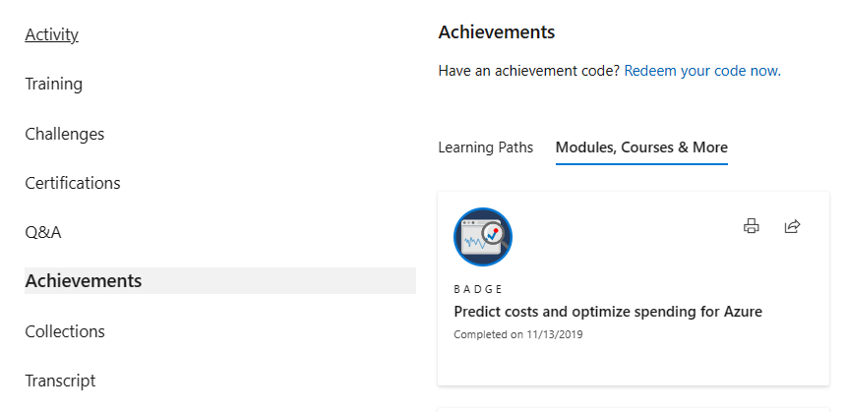
Celebrate your accomplishments and feel empowered
Get your achievement recognized and earn your badge for completing this course
aka.ms/MyMicrosoftLearnProfile
Go to Achievements on your Microsoft Learn profile
Redeem the code provided by your trainer
Find your new badge on Modules, Courses & More
Share your new achievement with your professional network. You can also download and print your certificate.
2
3
4
1

Slide 10

Become Microsoft Certified
92%
of certified IT professionals feel more confident in their abilities after earning certifications¹
Applied Skills Resources
Applied Skills poster Explore all credentials in a concise guide.
Choose your Microsoft Credential Microsoft Applied Skills or Microsoft Certifications? Choose the path that fits your career goals, desired skillset, and schedule.
¹ “2023 Value of IT Certification | Candidate Report,” Pearson VUE, 2023 ² Microsoft fundamentals certifications don’t expire

Slide 11

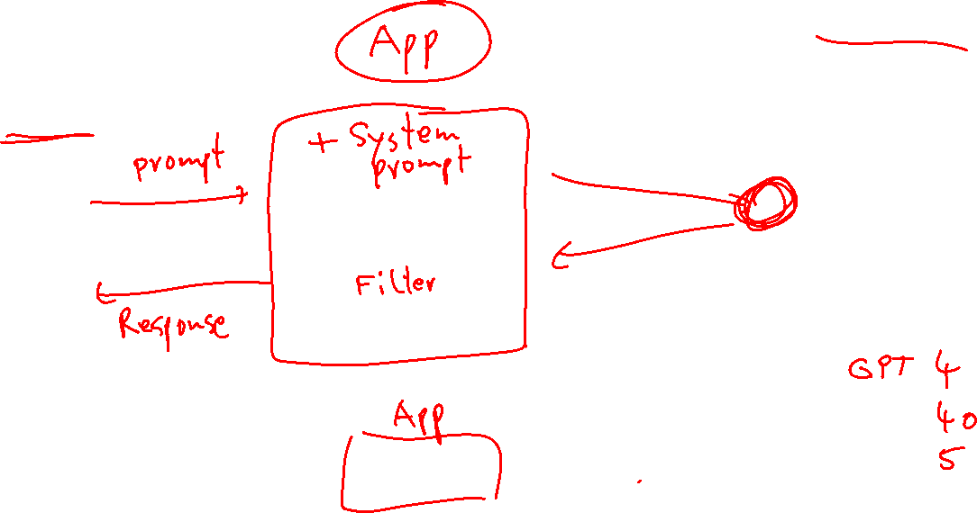
Architektur
Sprachmodell
LLM
Benutzer
API

Slide 12
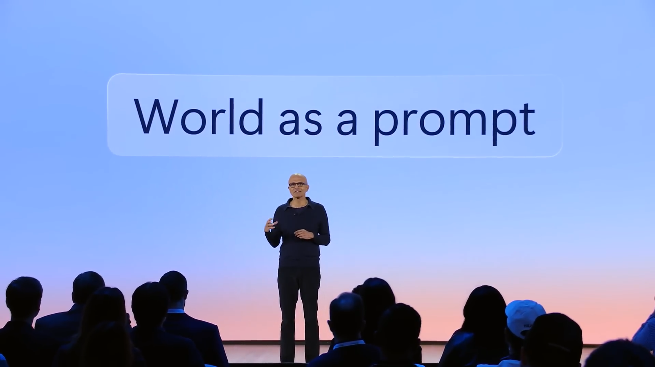
Notes:
Microsoft Build Conference 21. Mai 2024
https://youtu.be/aZbHd4suAnQ?t=266

Slide 13



Slide 14
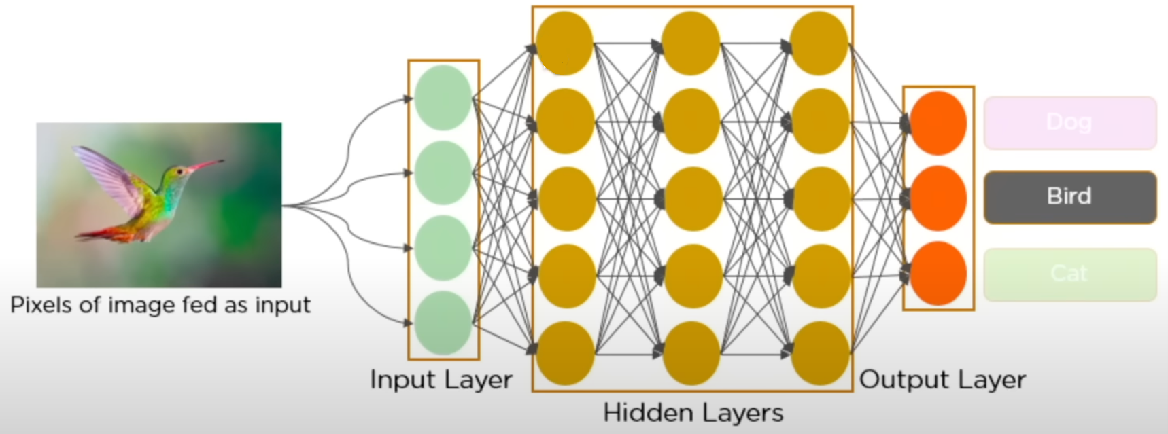
Neuronale Netzwerke

Slide 15
Architektur
Sprachmodell
LLM
Benutzer
API

Slide 16
Notes:
Microsoft Build Conference 21. Mai 2024
https://youtu.be/aZbHd4suAnQ?t=266

Slide 18
Neuronale Netzwerke

Slide 19

What is generative AI?
1956
Artificial Intelligence
the field of computer science that seeks to create intelligent machines that can replicate or exceed human intelligence
Artificial Intelligence
Machine Learning
1997
Machine Learning
subset of AI that enables machines to learn from existing data and improve upon that data to make decisions or predictions
Deep Learning
2017
Deep Learning
a machine learning technique in which layers of neural networks are used to process data and make decisions
Generative AI
2021
Generative AI
Create new written, visual, and auditory content given prompts or existing data.

Slide 20
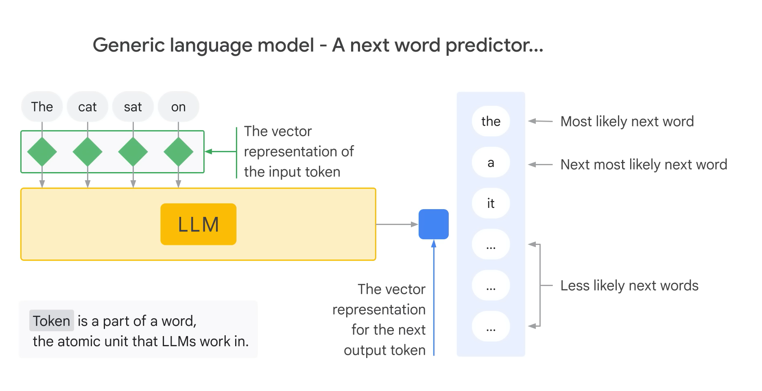

Slide 21

Sasha Luccioni, ars technical 2023
Über jedes Thema chatten
Erledigt die Hausaufgaben
Realistische Bilder erzeugen
Gibt Antworten auf alle Fragen
Ihre Daten werden gesammelt,
um Modelle zu verbessern
Falsche und irreführende Informationen
Propaganda und Täuschung
Vorurteile und Halluzinationen
Ausbeutung unterbezahlter Arbeitnehmer
Homogenität und Verflachung
Höhere Eintrittsbarrieren für KI
Schädlicher und gewalttätiger Inhalt
Viele Tonnen CO2-Emissionen
Privater Inhalt
Copyright-Verletzung
Riesige Mengen an Energie, Wasser, seltene Erden
Notes:
https://arstechnica.com/gadgets/2023/04/generative-ai-is-cool-but-lets-not-forget-its-human-and-environmental-costs/

Slide 22
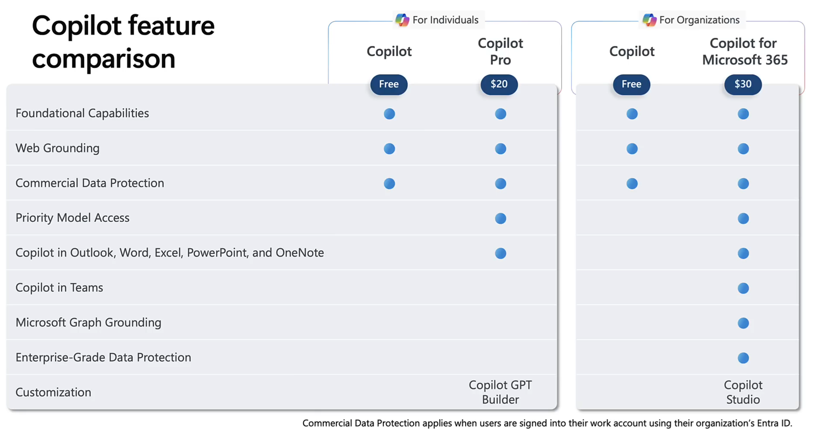

Notes:
https://youtu.be/r4irS6o2vJE?t=243

Slide 23
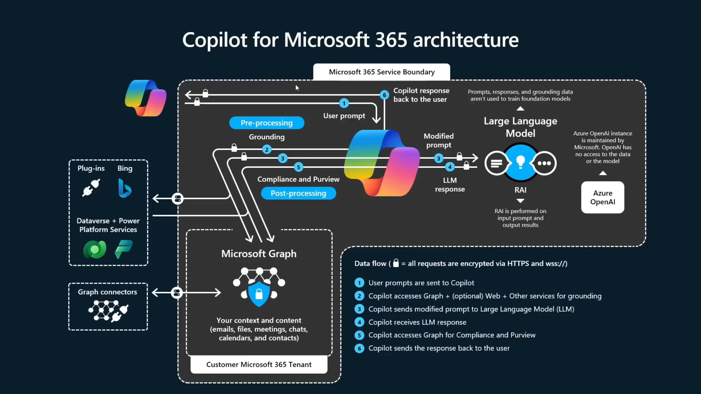
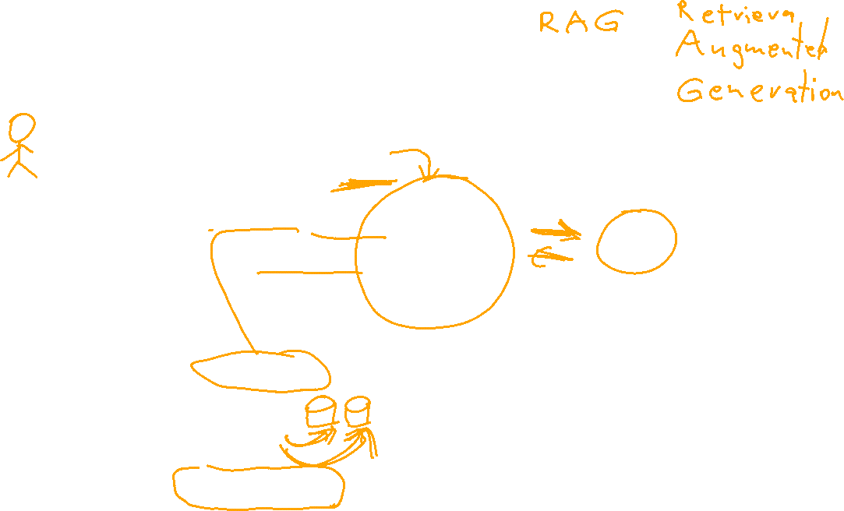
Notes:
https://youtu.be/F5wfOhnj0IU?t=451

Slide 24
Notes:
https://youtu.be/r4irS6o2vJE?t=243

Slide 25
Notes:
https://youtu.be/F5wfOhnj0IU?t=451

Slide 26
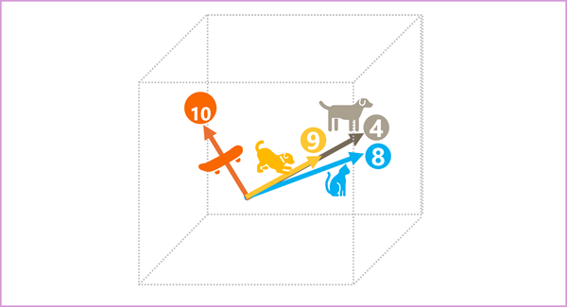
Embeddings
Notes:
https://learn.microsoft.com/en-us/training/modules/fundamentals-generative-ai/3-language%20models

Slide 27
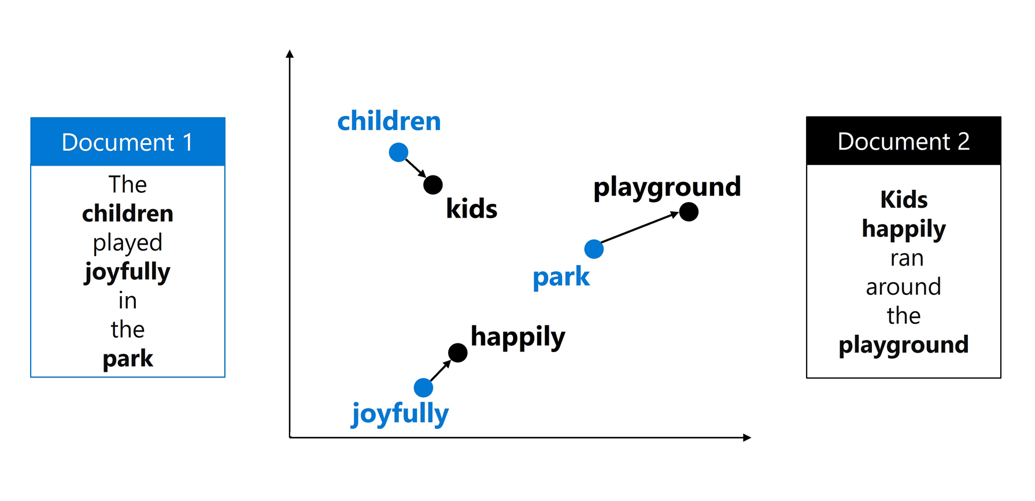

Vector Index
Notes:
https://learn.microsoft.com/en-us/training/modules/build-copilot-ai-studio/3-search-data

Slide 28
Tipp 1: Schreibe leserlich!
Rechtschreibung, Zeichensetzung, Groß- und Kleinschreibung
Tipp 2: Schreibe in ganzen Sätzen!
Es hilft dem Sprachmodell Dich zu verstehen.
Tipp 3: Bleib dran!
Der erste Prompt ist nicht der Beste.
Iterate! Iterate! Iterate!
Es ist Generative AI.
Tipp 4: Sei höflich!
umstritten

Slide 29

Welche Prompt Techniken gibt es?
Rollen Zuweisung
Zero-Shot Prompting
One-Shot Prompting
Few-Shot Prompting
Chained Prompting
Texte umformulieren / Ausgabe abändern
Markup generieren
Etc…

Slide 30
End of presentation

